Slide 1

Data analysis on us Health Insurance
ISYS 812: final PROJECT
NAME: Padmasree sappa
Prof. Guillaume faddoul

Slide 2


Objective:
Our project aims to uncover underlying trends and determinants that influence health insurance charges in the United States.
By analysing demographic, health, and lifestyle data, we seek to provide actionable insights that could influence policy making and personal health decisions.

Slide 3
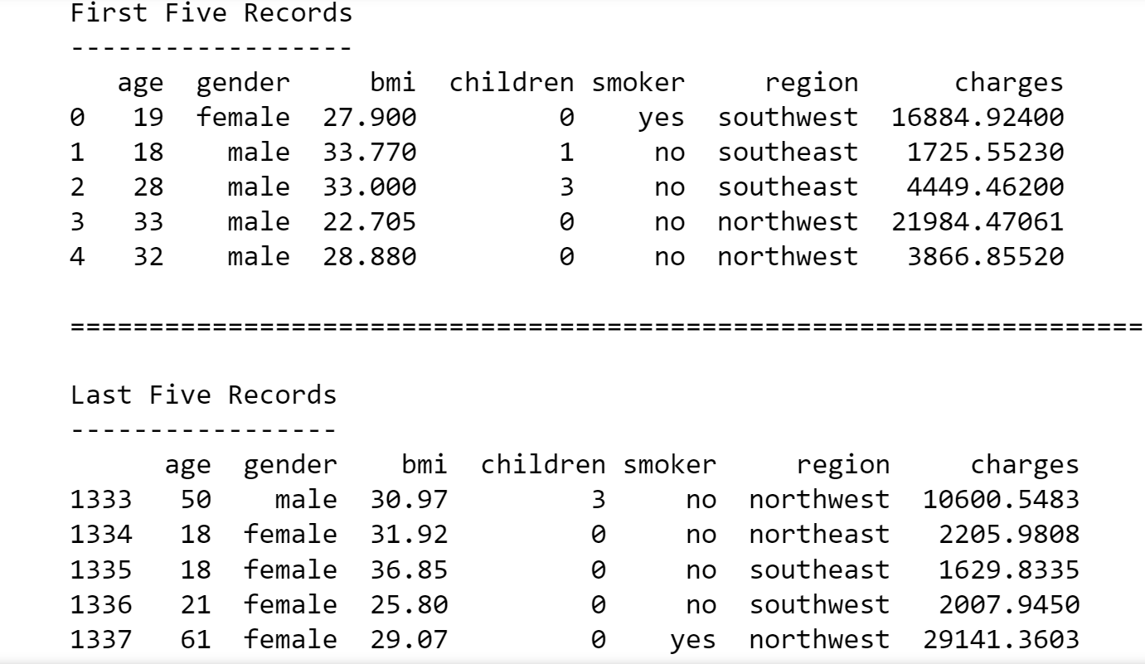
About the dataset:
Why this project
Addressing healthcare affordability
Practical Application
Description:
Size of the dataset
Contents
Why this dataset?
Analysis Goals:
Factors influencing insurance charges
Predict charges
US Health Insurance
Kaggle link: https://www.kaggle.com/datasets/teertha/ushealthinsurancedataset/data

Slide 4
What to expect:
Detailed exploratory data analysis to understand correlations and patterns.
Predictive models to estimate future insurance charges.
Discussion of significant insights with real-world implications.
DRIVING QUESTION
Main factors influencing health insurance charges
How to predict charges based on those factors?

Slide 5
OUTLINE:
Introduction and Objectives
Dataset Overview and Initial Insights
Detailed Exploratory Data Analysis
Predictive Modelling and Results
Key Insights and Policy Implications
Conclusion

Slide 6



Data cleaning:
1
ROW
ROW
OUTLIERS

Slide 7
Data manipulation:
One-hot Encoding
Gender
Added new columns
Smoker status
Outliers
Region

Slide 8
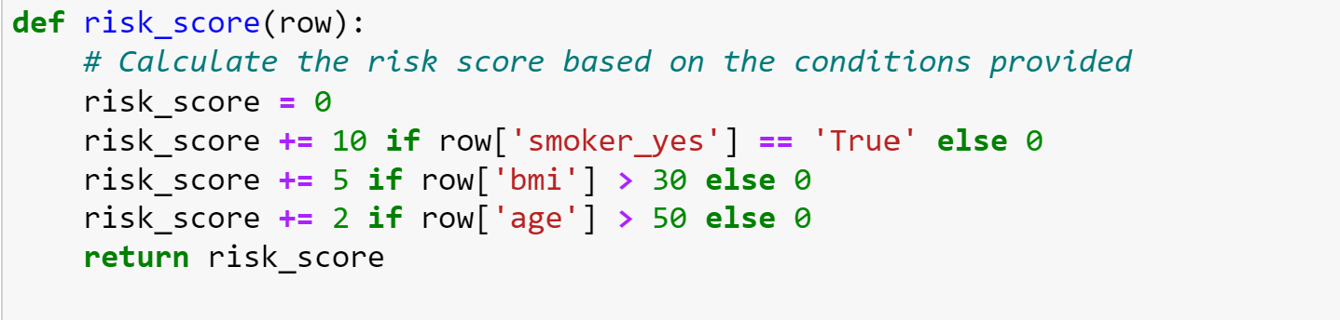
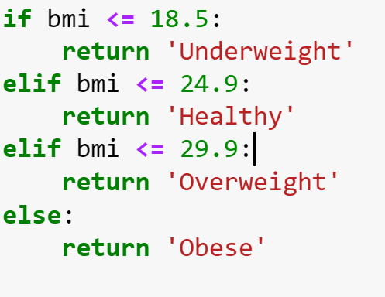
Data manipulation (CONTD.):
One-hot Encoding
Risk Score
BMI Category
Added new columns
Outliers

Slide 9
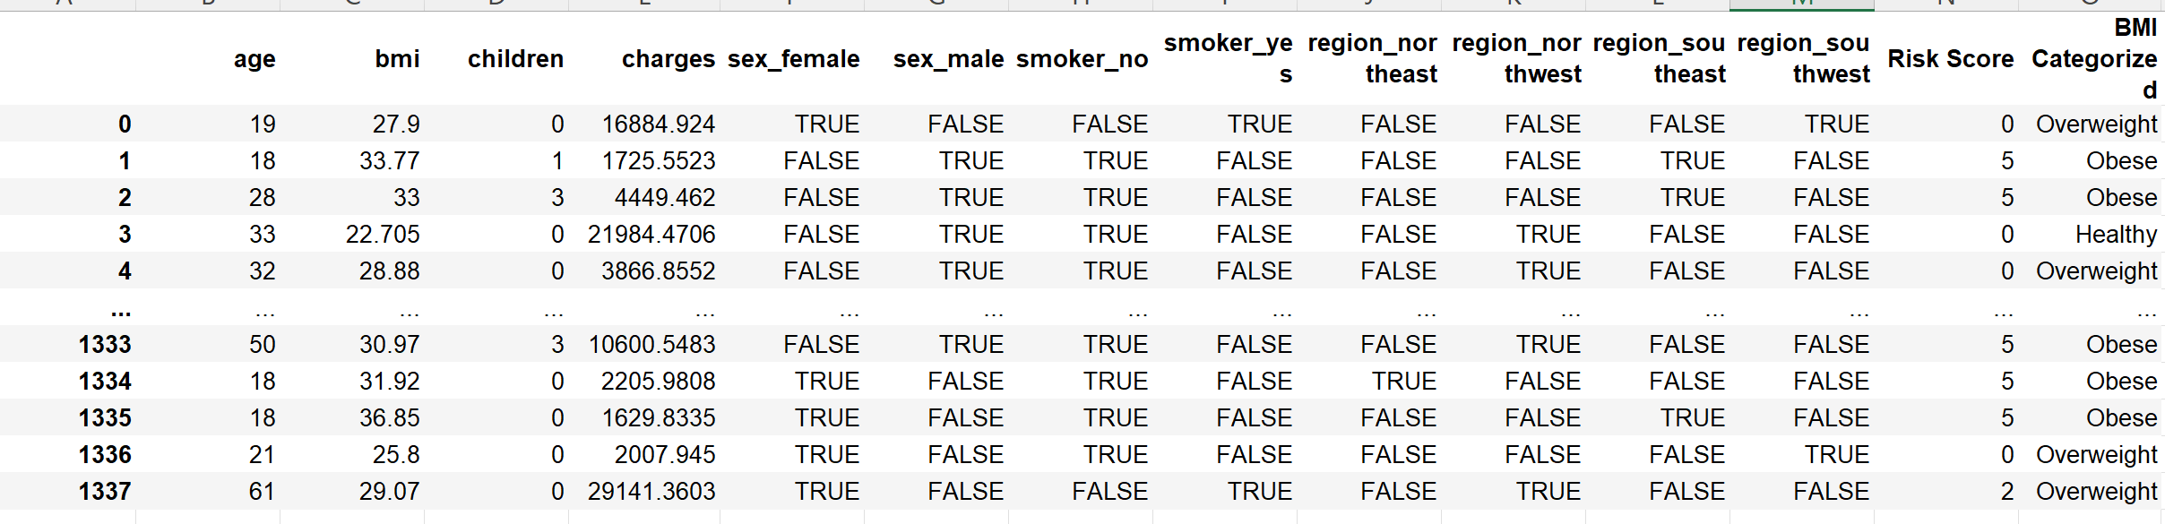
Modified dataset:

Slide 10
Data manipulation (contd.):
One-hot Encoding
Added new columns
BMI: 7
CHARGES: 139
Rows with outliers: 1337
Rows without outliers: 1190
147
Outliers
Should we ignore major data points/ records?

Slide 11
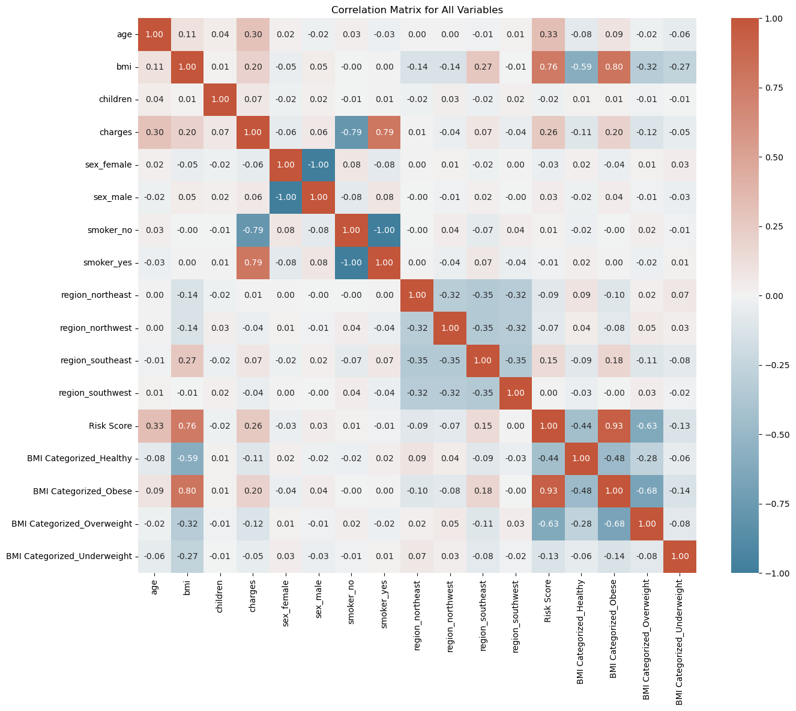
Data analysis – (pre-analysis):
Smoker status:
0.79
Age:
0.30
BMI:
0.20
Children:
0.07

Slide 12
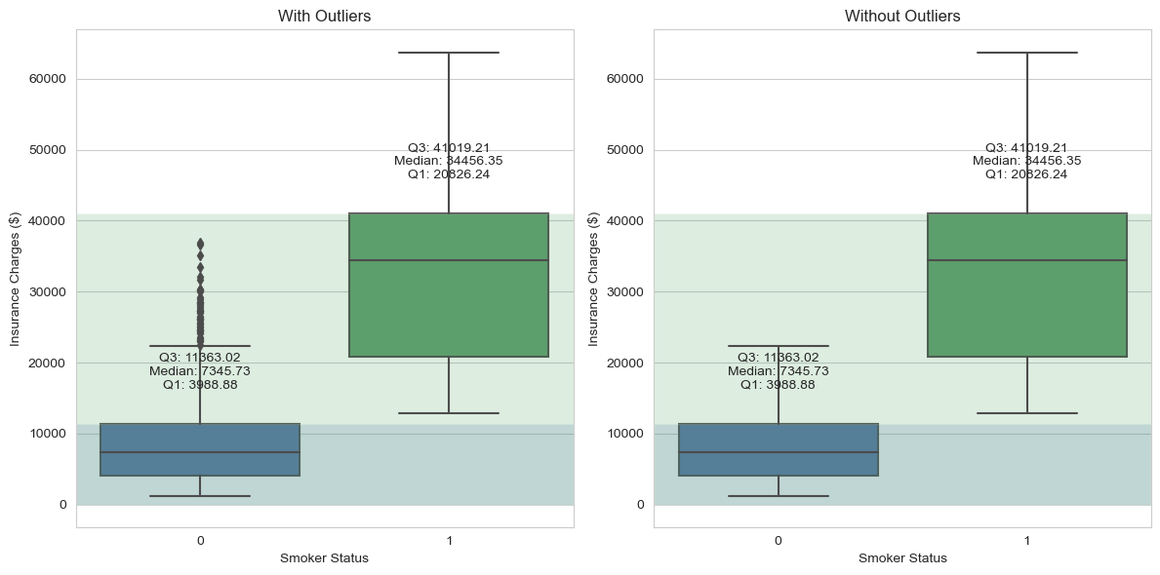
Comparing the datasets for both cases:
Charges VS Smoker status:
Dataset without outliers
Dataset with outliers

Slide 13
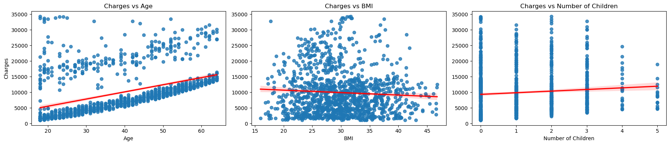
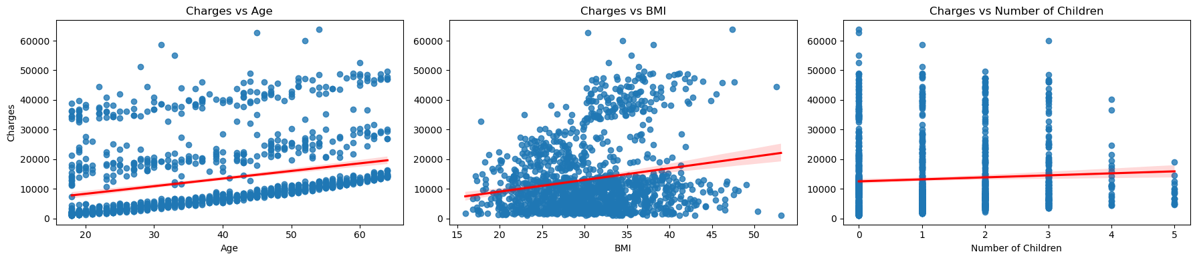
Comparing the datasets for both cases:
Charges VS Age:
Dataset without outliers
Dataset with outliers

Slide 14
Comparing the datasets for both cases:
Charges VS BMI
Dataset without outliers
Dataset with outliers

Slide 15
Comparing the datasets for both cases:
Charges VS Children:
Dataset without outliers
Dataset with outliers

Slide 16
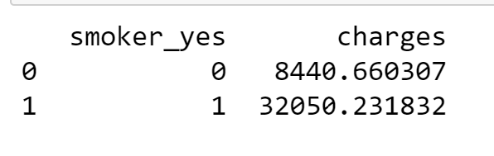
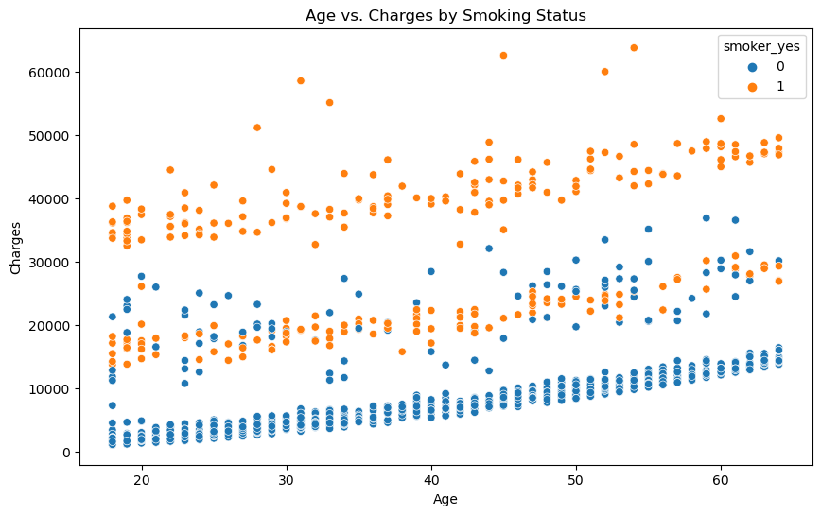
Insight-1: impact of Age, smoking on charges
Avg. non-smoker’s insurance charges
Findings:
Avg. smoker’s insurance charges
Policy implications:
Used to justify a higher premium for smokers.
Brand public initiative program focusing on smoking.

Slide 17
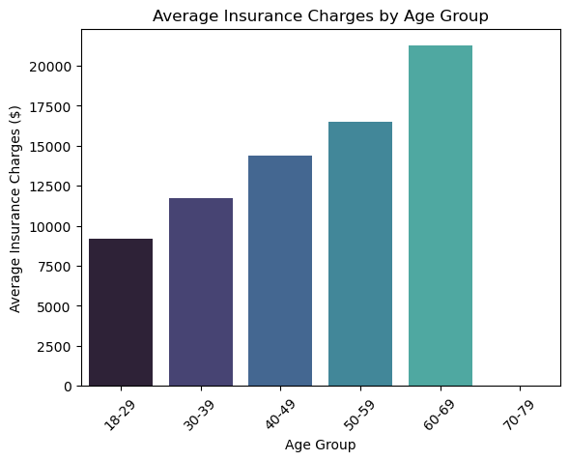
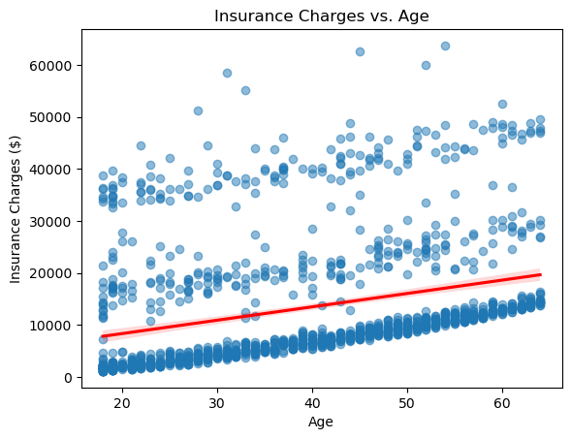
Insight-2: increase in charges with age
Findings:
corr = 0.30
Insurance charges age
Policy implications:
Health interventions or adjust insurance premium structures to accurately reflect the increasing risk and associated cost as per age.
Promoting preventative healthcare measures among younger age groups.

Slide 18
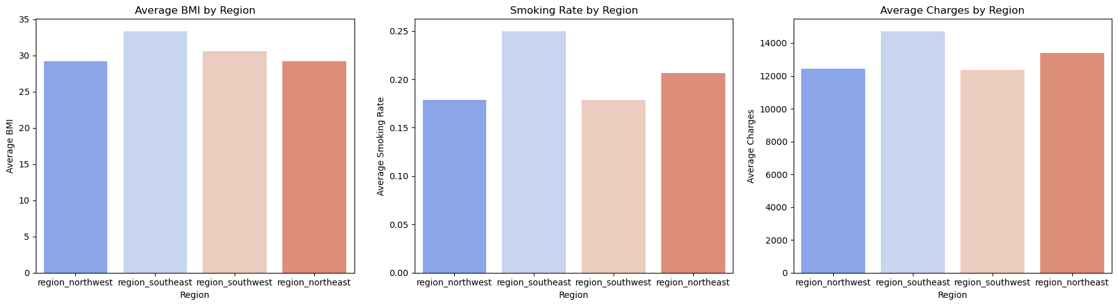
Insight-3: Charges variation based on regions
Policy implications:
Conduct public health campaigns or subsidized health programs focusing on smoking cessation and obesity.

Slide 19
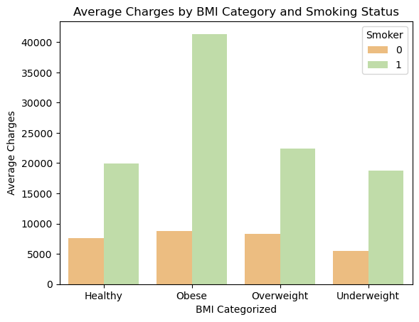
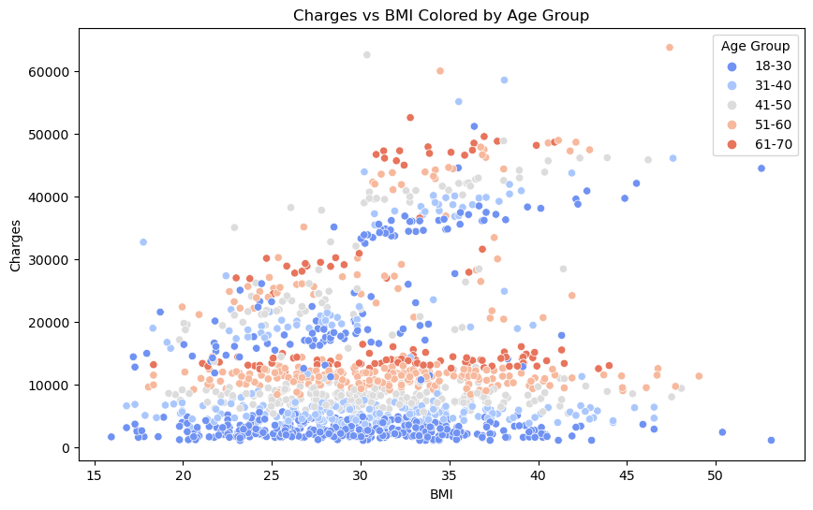
Insight-4: TRENDS based on Bmi & smoking.
corr = 0.20
Insurance charges BMI
Policy implications:
Conduct public health campaigns to adapt a healthier lifestyle.

Slide 20
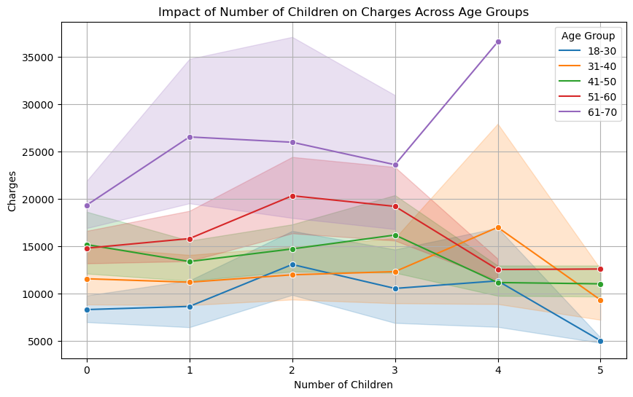
Insight 5: Influence of Children on charges
Policy implications:
Insurance planners can consider this analysis to estimate cost of adding dependents to their policies.

Slide 21
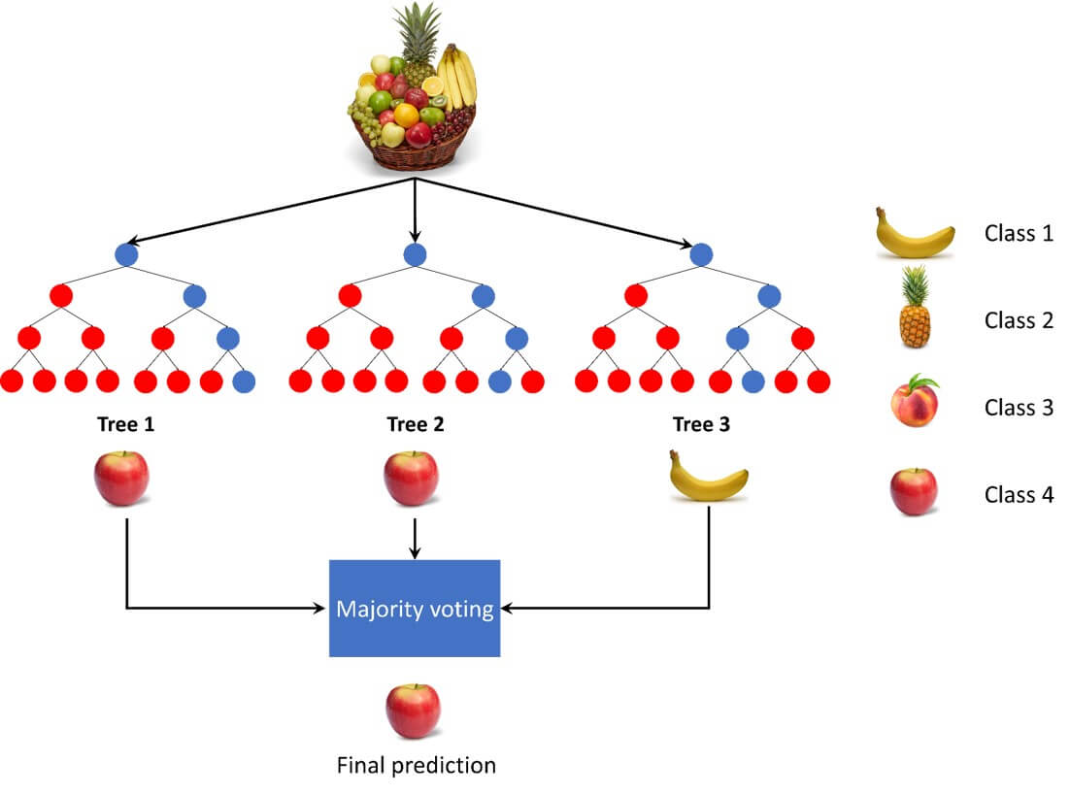
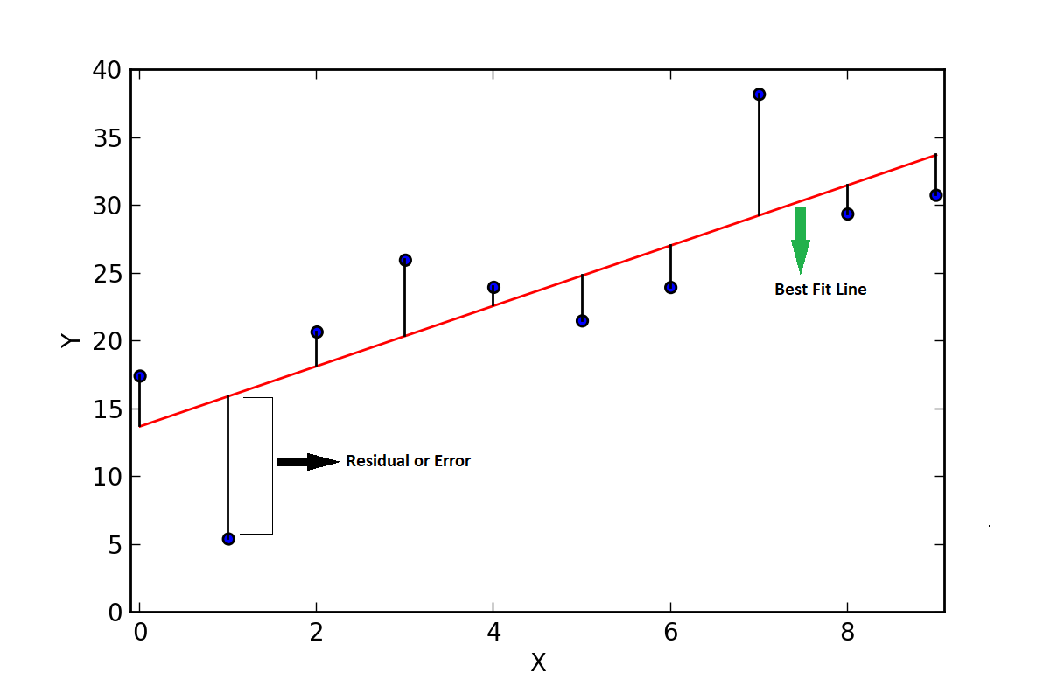
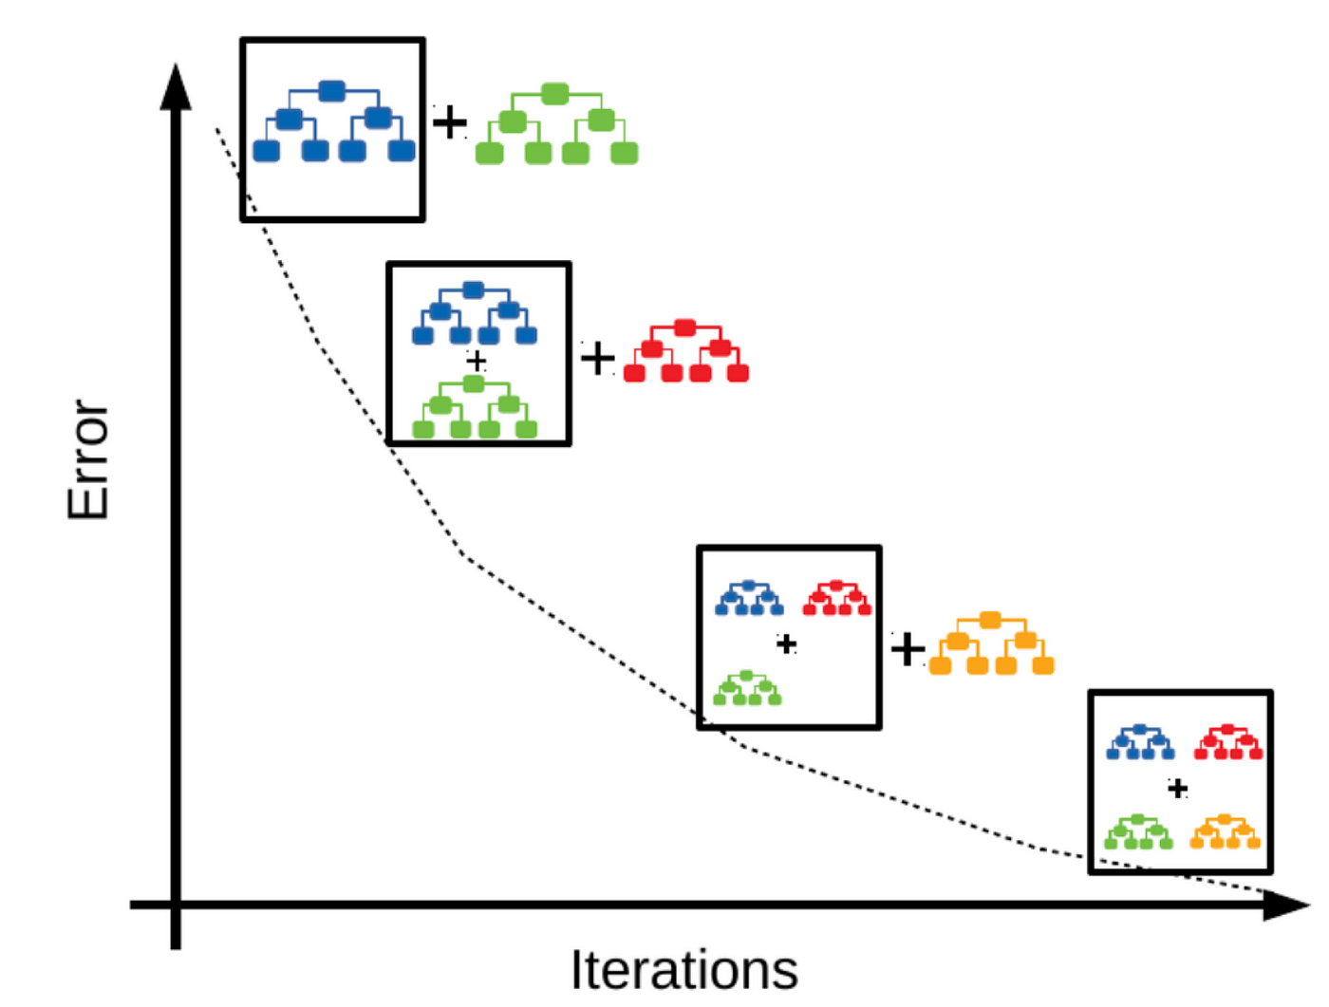
Predictive modelling:
Future health insurance charges
Based on
Attributes in the dataset
Linear Regression
Random Forest
Gradient Boosting

Slide 22
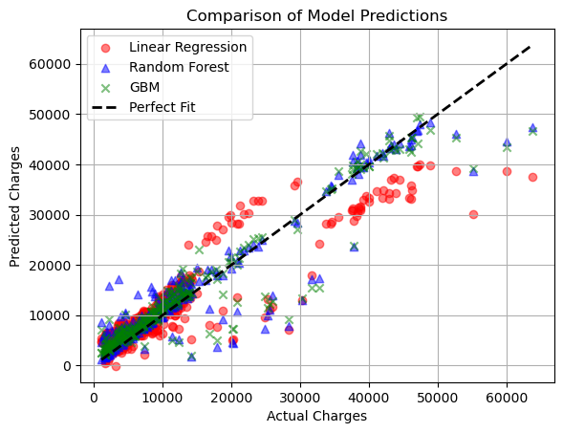
Comparisons of the model prediCtions:

Slide 23
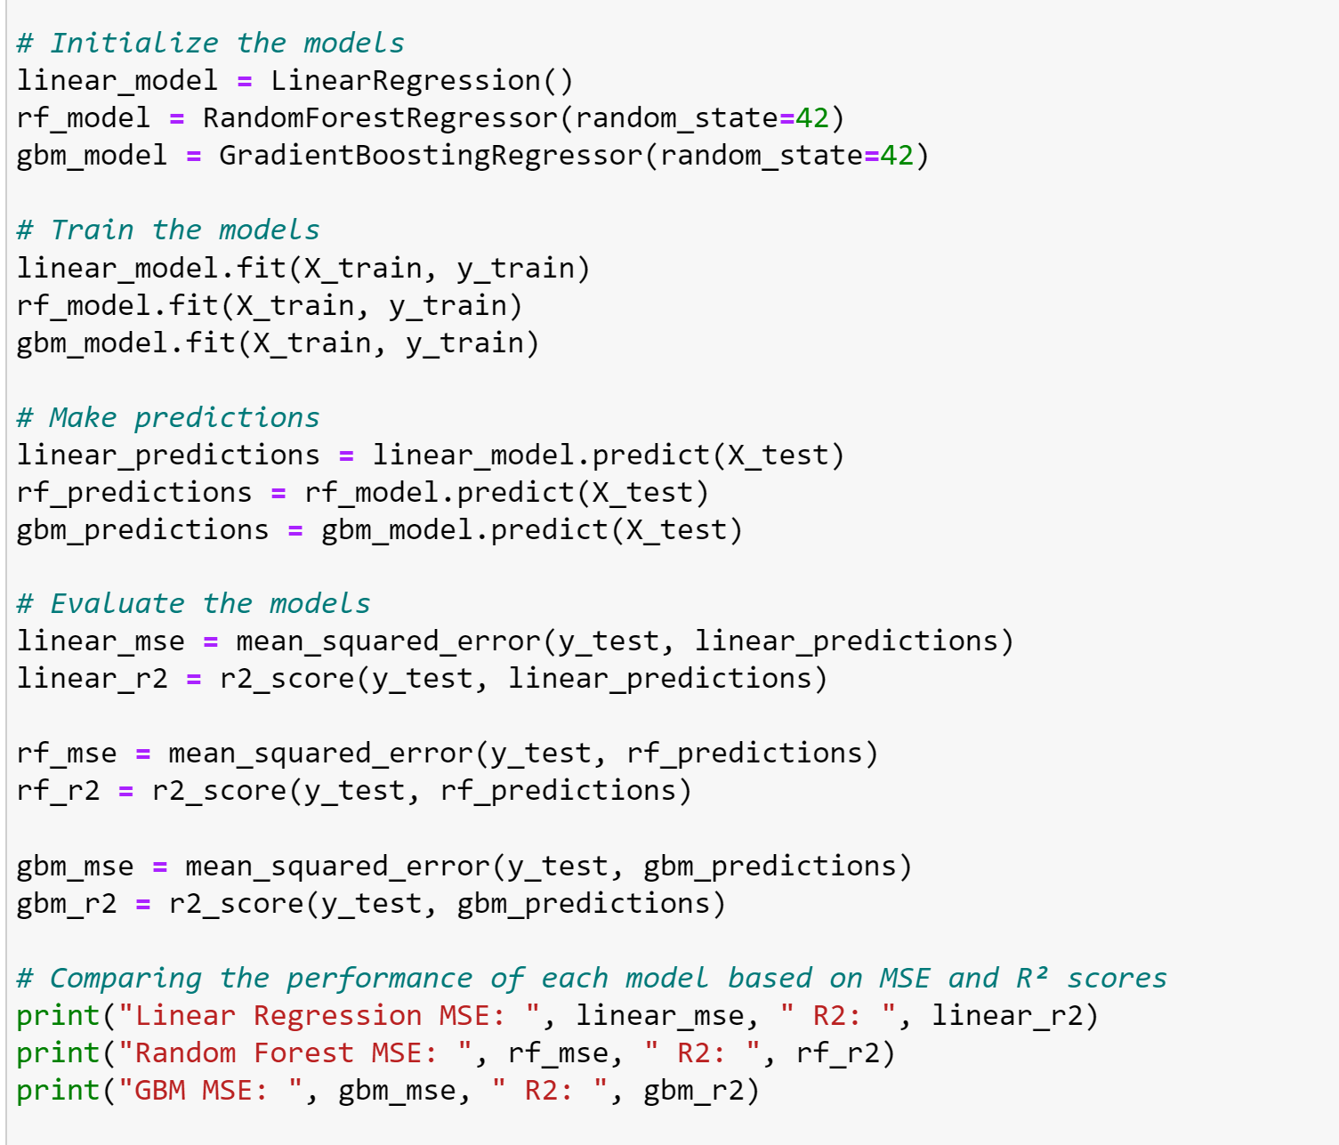
Dataset training and testing:
Model training
Test Results

Slide 24

CONCLUSION:
Smoking
Family-Friendly Insurance Plans
Children
Charges
Tailored Health Policies
Region
BMI
Regional Healthcare Equity
Age

Slide 25


Slide 26


